Slide 1
Properties of Regular Languages
Chapter – 4
4.1 – Closure Properties of Regular Languages

Slide 2
Closure Properties of Regular Languages
If L1 and L2 are regular languages, then so are
L1 ∪ L2,
L1 ∩ L2,
L1L2,
__
L1 ,
L1*
The family of regular languages is closed under union, intersection, concatenation, complementation, and star-closure.

Slide 3

Proof:
If L1 and L2 are regular, then there exist regular expressions r1 and r2 such that L1 = L(r1) and L2 = L(r2).
By definition, r1 + r2, r1r2, and r1* are regular expressions denoting the languages L1 ∪ L2, L1L2, and L1*.
To show closure under complementation,
let M = (Q, Σ,δ, q0,F) be a dfa that accepts L1.
__
Then the dfa accepts L1

Slide 4





Assume δ* to be a total function, so that δ* (qo,w) is defined for all w ∈ Σ*.
Consequently either δ*(q0,w) is a final state, in which case w ∈ L, or δ*(q0, w) ∈ Q − F and w ∈
To demonstrating closure under intersection Let L1 = L (M1) and L2 = L(M2), where M1 = (Q,Σ,δ1,q0,F1) and M2 = (P,Σ, δ2,p0,F2) are dfa's.
So the combined automaton whose state
set consists of pairs (qi, pj), and whose transition function is such that is in state (qi, pj) whenever M1 is in state qi and M2 is in state pj. So
Where and

Slide 5


Using DeMorgan’s Law, taking complement on both sides of
If L1 and L2 are regular then by closure under complementation , Union and again complementation , is regular.
Similarly regular languages are closed under difference as well as under reversal.

Slide 6
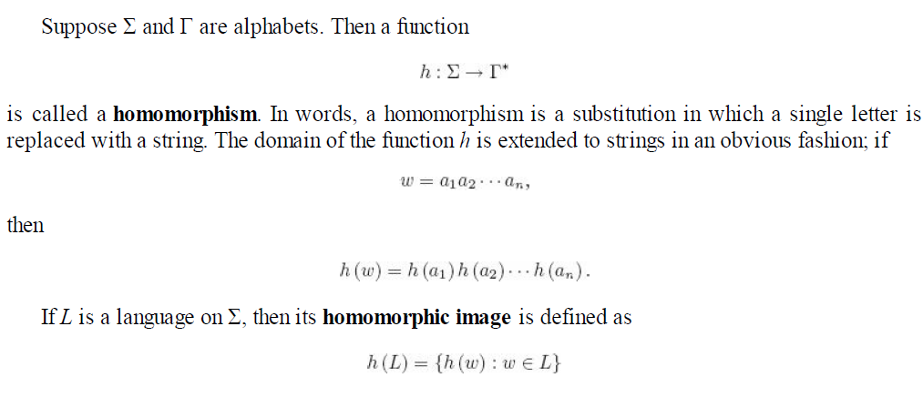
Homomorphism
Definition of homomorphism is given as

Slide 7

Example 1:
If L is a regular language, then its homomorphic image h (L) is also regular. The family of regular languages is therefore closed under homomorphisms.

Slide 8
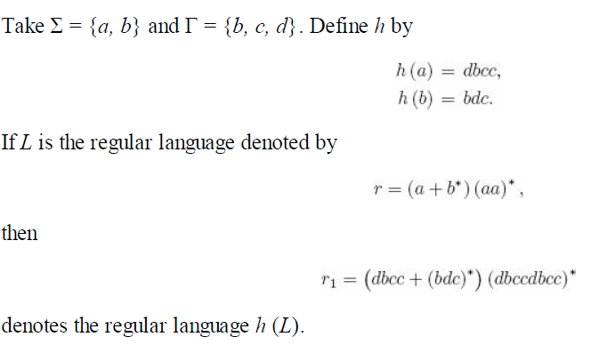
Example 2:

Slide 9
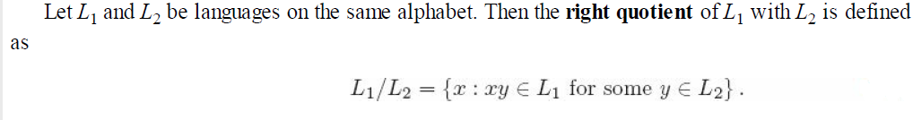
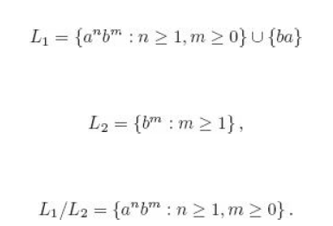
Right Quotient
Example 1:

Slide 10

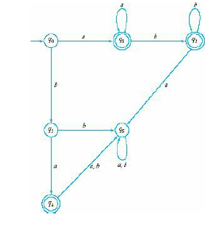

L(M0) = aa* + aa*bb* + ba
L(M1) = a* +a*bb*
L(M2) = b*
L(M3) = a
L(M4)= λ
L(M5) =Φ
Now Find intersection with L2
L(M0):
L(aa* + aa*bb* + ba) ꓵ L(bb*) = Φ
L(M1):
L(a* +a*bb*) ꓵ L(bb*) ǂ Φ
L(M2):
L(b*) ꓵ L(bb*) ǂ Φ
L(M3):
L( a) ꓵ L(bb*) = Φ
L(M4):
L(λ) ꓵ L(bb*) = Φ
L(M5):
L(Φ) ꓵ L(bb*) = Φ
Now only make M1 and M2 as acceptor in L1/L2

Slide 11

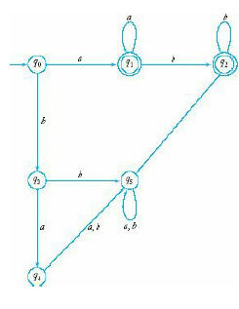
Output after making q1 and q2 as acceptor state

Slide 12


Try Example 2…..

